Slide 1

Fake News Detector Covid19 Hackathon Idea Submission
Submitted By:
Dharmendra Pathak (AIIR05-Droit)
Ph.D Scholar, A80166220005 (Batch 2)
Amity School of Engineering and Technology
Amity University Chhattisgarh, Raipur

Slide 2
Topics to be covered….
Problem Statement
Proposed Solution
Solution Approach
Solution Workflow
RUN-TIME Results
USP of the Solution

Slide 3
Problem Statement
To come up with solutions by utilizing heatmaps, like geotagging high risk zones and marking those through heatmaps, or in other ways use clusters to markdown the fake news and its origin.

Slide 4
Proposed Solution
Generation and using GeoTagging for the detection of Covid-19 Fake News from Twitter Data of HOTSPOT States using Deep Learning Framework

Slide 5
Solution Approach
The proposed solution generates the geotag of the most affected states by means of the timely synchronized and filtered data set collected from trusted government source. Then on the basis of most affected regions, filter the twitter data of Covid-19 and detect the fake news using Gated recurrent unit (GRU) deep learning algorithm.
Following are the key elements of the idea proposed:

Slide 6
Solution Approach….
1. Authentic Data Set:
The data set is collected from the government website i.e. https://www.mohfw.gov.in/ and timely synchronized with it for the generation of real-time maps. The attributes of data set are Name of state, Total Confirmed cases, Cured/Discharged/Migrated, Death and Twitter Data Set is collected from https://ieee-dataport.org/open-access/corona-virus-covid-19-tweets-dataset
2. Platform/Framework used:
The proposed solution implements the libraries/APIs of Deep Learning using Python Programming Language as follows:
HTTP web scraper
GeoPandas
Matplotlib and Seaborn
Online GIS Mapping
TensorFlow and Keras
SkLearn

Slide 7
Solution Workflow
Data Set Scraping from
https://www.mohfw.gov.in/
Preprocessing of collected data
Reading the Indian States Map File through GeoPanda
Correlate Data and Plot the GeoTag Data Statewise on the Map of India
Prepare testing data and apply the trained GRU model for for prediction of fake news /article
Tokenizing the tweet text for learning and prepare the GRU algorithm based model and perform learning on training data
Eliminates Outliers and Divide the data into training and testing sets and assign labels to train twitter data
Identify the majorly affected states and filter the twitter data from https://ieee-dataport.org for those regions
Figure: Proposed Solution Workflow

Slide 8
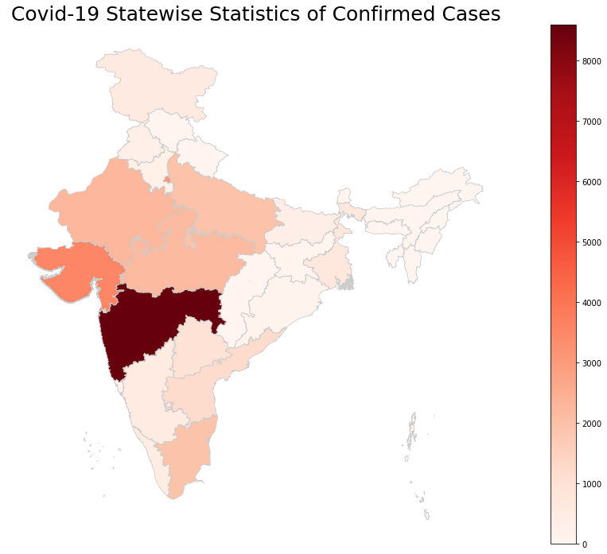
RUN-TIME Results
a. Indian States GeoTagged Covid-19 Hotspots Map

Slide 9
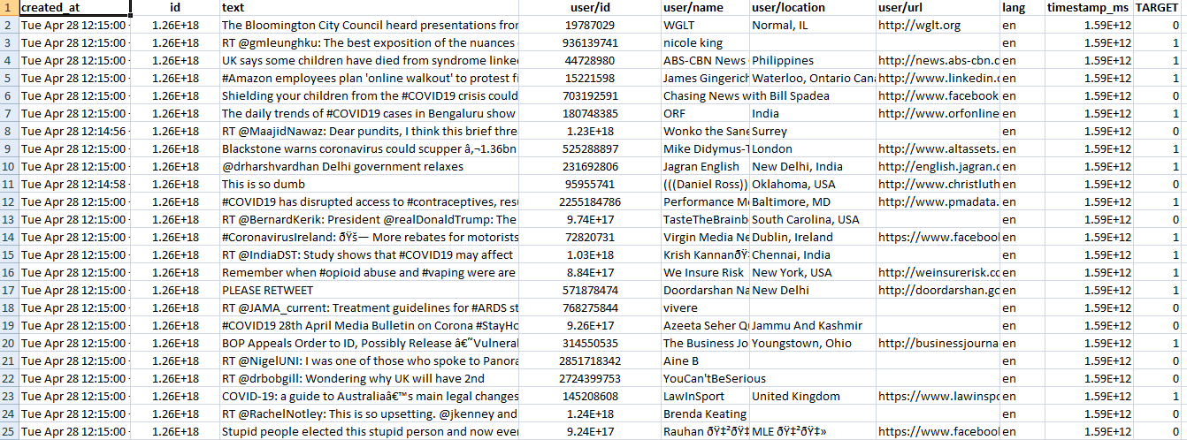
RUN-TIME Results
Covid-19 Twitter Data at a glance

Slide 10
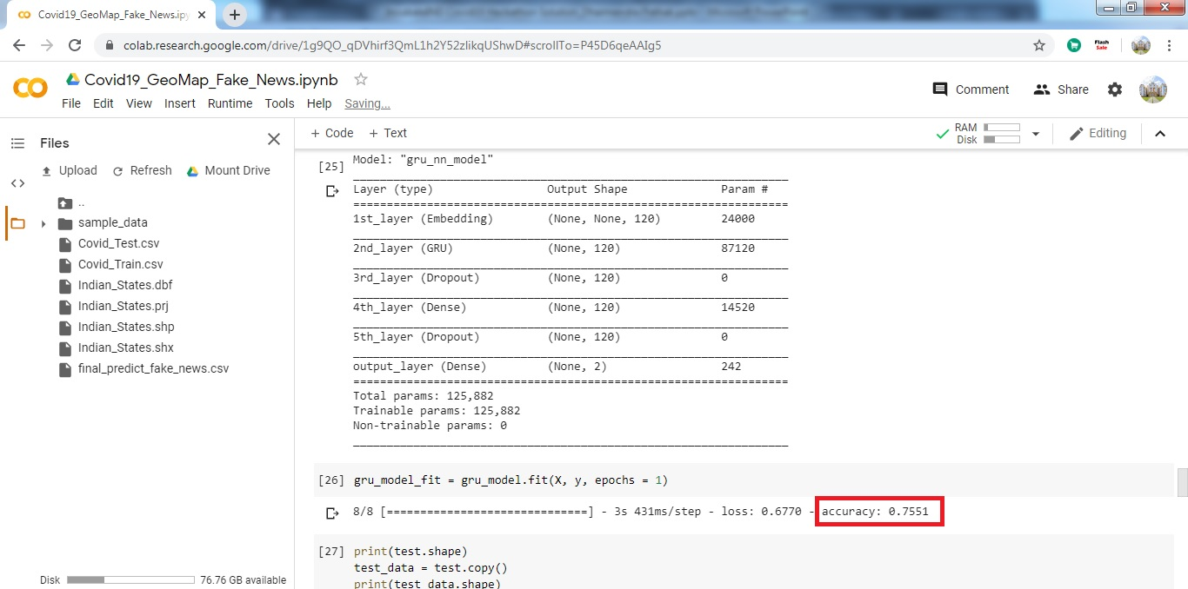
RUN-TIME Results…..
b. Gated recurrent unit (GRU) deep learning algorithm Accuracy Snapshot for the training of Covid-19 Twitter Data with accuracy of 75.51 % for the detection of Fake News

Slide 11
USP of Solution
I. Real-time and synchronized tracking the impact of Covid-19
II. Filtered data from the authentic source
III. Better state-wise visualization through GeoTagging model
IV. Trained Deep Learning model can be used for the identification of fake news and articles against large user twitter database
V. Very helpful while taking further important decisions e.g. extending lockdown, food delivery, medical checkups etc.

Slide 12
Pricing, Time Line & Support Needed
It is a machine learning based solution and implemented on open source APIs.
The proposed idea has already been implemented.
Hosted on Google Colab Platform, which is free of cost. Apart from this only requirement of the solution is High Configuration System (Processor+RAM+GPUs+SSD) for processing.

Slide 13


